Slide 1

Postal 2 Darter Road
Ze Bali Security Lodge
Greenhills, Randfontein, 1759 Cell: 073 566 2161
Email: Phepoholdings@gmail.com

Slide 2
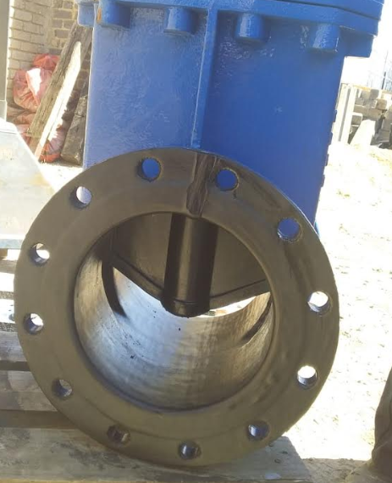
ABOUT US
We are Mmaphepo Holdings Company situated in Randfontein Gauteng. Our main focus is to minimize “down time “ on production as well as on giving solutions, Specialize in sourcing all type of product. Everything from perishables to non-perishables , mining, construction, agricultural, and petrol chemicals , wide range of product and services
“A Truly South Africa Company “

Slide 3
MISSION, VISION AND CORE VALUES
MISSION
To provide a service that will add sustainable s value-engineered solutions to the operation of our clients in commerce, industry and the public sector.
We strive to understand our Client’s needs and to deliver service excellence with uncompromising passion and quality.
VISION
Our Vision is to be the Mining and Infrastructure Specialists of choice in the markets we serve
CORE VALUE
Excellence
Passion and Quality
Employee development and advancement
Customer Focus
Leadership
Solutions Orientated
Health, Safety & Environment
Social Responsibility

Slide 4
Tools and equipment
TOOLS AND EQUIPMENT PRODUCT
FASTENING
Cable ties
Riveters
Staple guns
Locking, Seals
Strapping & buckles
Strapping Tools
IRON TOLLS
row, Tommy & Pinch bars
Bolsters
Chisels
Cold Slates
Marlin spikes
Anvils
BUILDING
Sealants, tapes, Foams & adhesives
Levels
Measuring tapes
Trowels & Floats, straight edges, etc.
Laser distance levels.
Garage & Workshop Equipment
Creepers
Pannelbeating tools & Spray Guns
Bearing pullers
Engine Transmissions
Vehicle Jacks and Tressels
Parts washers
Oil drainers
Workshop presses

Slide 5
Tools and equipment
Tools and Equipment Product
ELECTRONIC
Batteries
Torches
Multimeters
Plugs
Connectors
Extension Reels
Lighting
Soldering Irons
ELECTRICAL
Electrical Test & Measurement Equipment
Insulation tapes
Cable cutters and crimpers
Soldering
Cable ties
POWER TOOL
Impact Wrench
Grinder
Blower
Saw
Accessories
Drill
Blower
Glue Gun
Grinder
Hot Air Gu
EXT..
PLUMBING
Pipe threading
Pipe bending
Pipe cutters
Soldering
CUSTORS & LADDERS
Ladders
Castors

Slide 6
Tools and equipment
Tools and Equipment Product
LIFTING &RIGGING
Chain Hoists
Lever hoists
Slings
Jib Cranes
Eye Bolts
Wire Rope
Wire rope clamps
Electric Hoists
TOOLS AND EQUIPMENT
Abrasives
Brush ware
Spanners
Wrenches
Socket and Accessories
Hand tools
DIGGING PICKING AND RAKING
Spades
Shovels
Forks
Rakes
Wheelbarrows
Picks

Slide 7
POWER TRANSMISSION PRODUCT
POWER TRANSMISSION PRODUCT
CHAIN
Cable carrier chains
Transmission and conveyor chain
Mining drive chain
Drop forged scraper chain
Elevator bucket chain
Leaf Chain
IRONWARE
Various coupling types
Full range of pulleys
Sprockets
Torque limiters
Universal joints
Locking elements
Taper-lock bushes
Bolt-on and weld-on hubs
DRIVERBELTS
V- and wedge belts
Powertwist Drive & Move belts
Variable speed belts
Banded belts
Poly-V belts
Synchronous belts z
OUR BRANDS,
HUTCHINSON, BTC, TSUBAKI, FENNER, DONGHUA, ESCO, WEBB, ZMC, KABELSCHLEPP, TRANSFLUID, QUICK-FLEX, RATHI, GATES, FALK & SYNERGY.

Slide 8

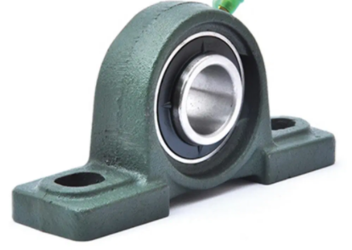
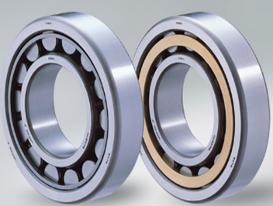
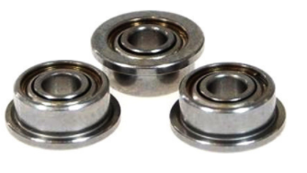
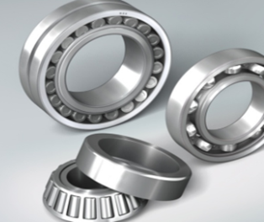
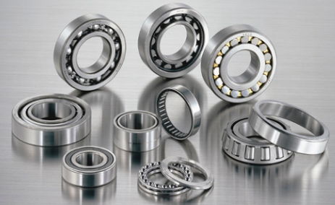
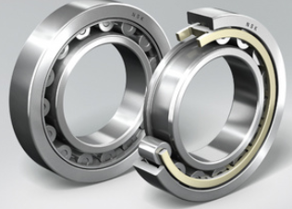
Bearings
SM Walking Tall Mining proudly suppliers the full range of bearing products and associated components to industry.
Ball Bearing
Roller Bearing
Super Precision Bearing
Miniature Bearings
Ball Bearings Units
Spherical Roller housed Units
Plummer Blocks, Sleeves & Accessories
Steel Bals & Rollers
Needle Bearings
Bearing Pulley

Slide 9
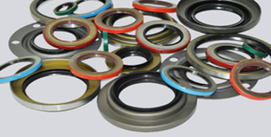
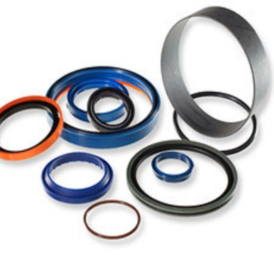
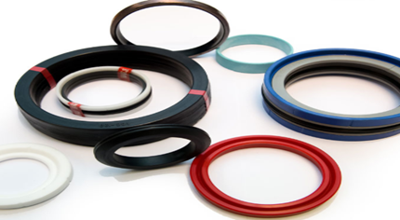
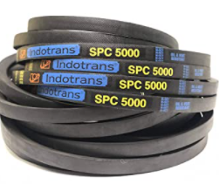
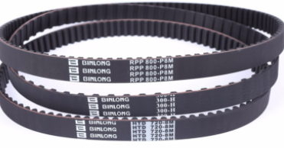
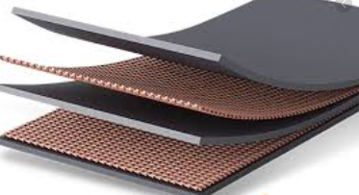
Seals , V Belt & Conveyor Belt
SM Walking Tall Mining proudly suppliers the full range of seals products and associated components to industry.
Industrial rotary shaft seals
Toric/face seal
O-ring kits & Cord
Nilos - Rings
Pneumatic Seal
Hydraulic Seal
Single sprig Mechanical Seals
Bonded Washer
Waved Washers

Slide 10
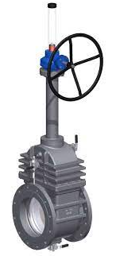
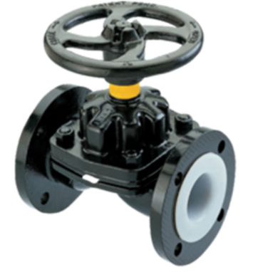
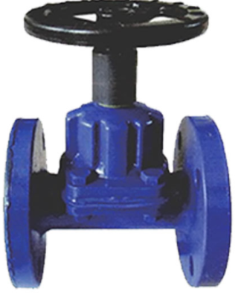
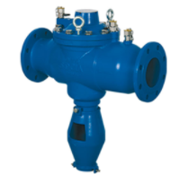
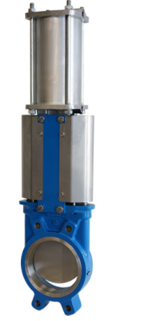
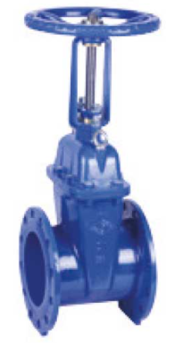
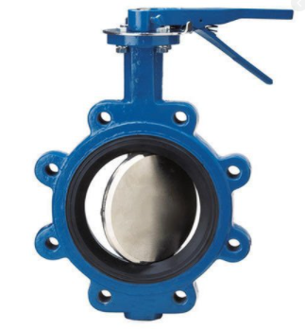
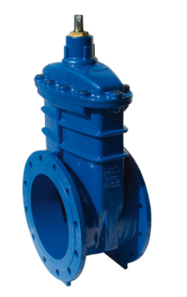
Valves and Pumps
SM Walking Tall Mining Valves range available in a wide range of linings to meet any application’s requirement. Complementing the diaphragm range is a long and short open frame pinch valves for slurry application
Double Bock & Bleed Gate Valve
A-Type
KB Valves
Diaphragm Valve (Straight Through types
Diaphragm Valves
Butterfly Valves
Gate Vales
Check Valves
Ball Valves
Slurry pump
Valves Rubber Line
Electric Pressure Pump
Knife Gate Valve
Gate Valve
Butterfly Valve
RSV Valve

Slide 11
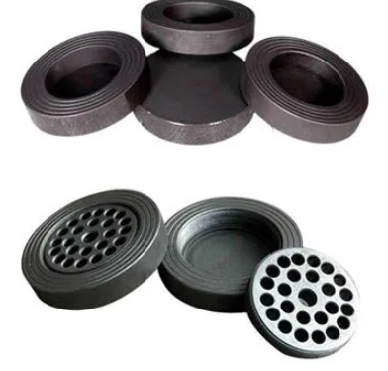
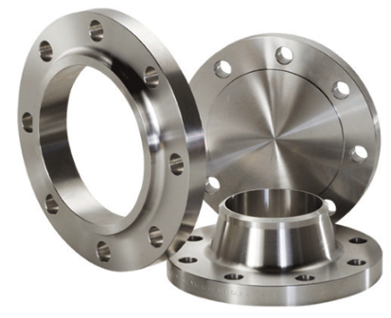
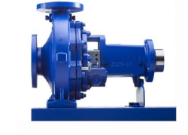
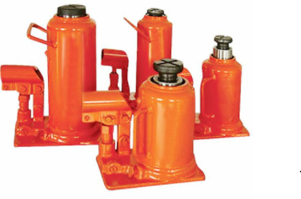
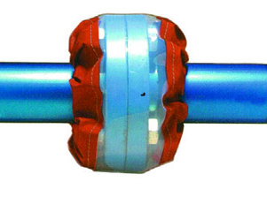
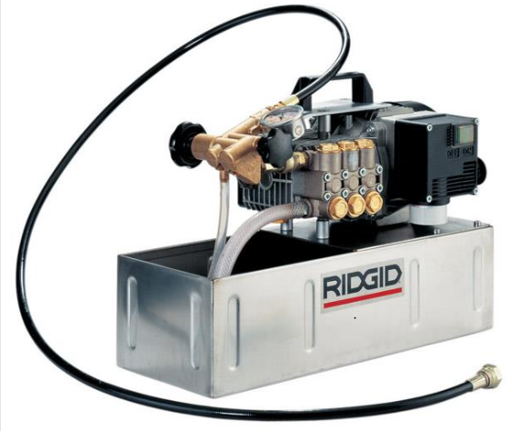
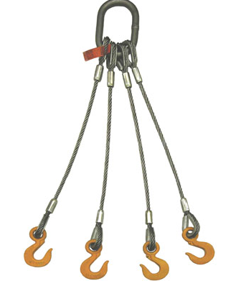
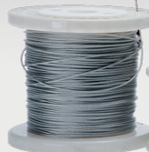
Popular Product Ranger
Rapture Pressure burst disc
Flanges
PUMP Centrifugal Eltanorm
Hydraulic jack
Flange Cover LFP
Electric Pressure Test Pump
Safety Slings
Mining Steel Wire Rope

Slide 12
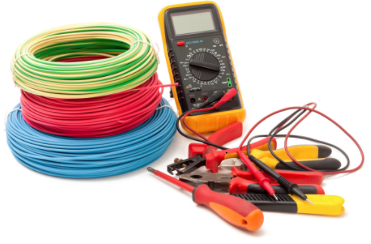
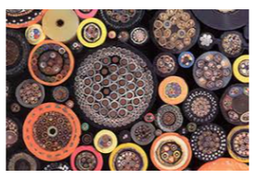
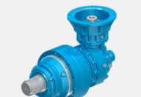
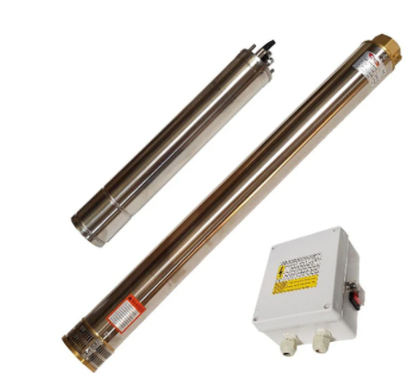
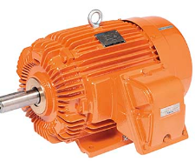
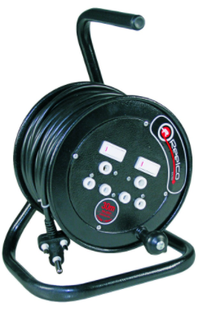
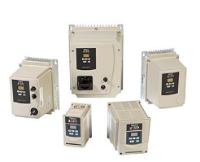
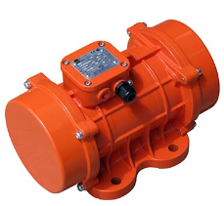
POWER GENARATION
Cables
Industrial Planetary
Gearbox
Borehole pump (complete
Multimeter
Motor Control &
Accessories
AC Motor
Steel Extension Reel
Vibrating

Slide 13
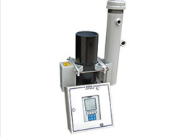
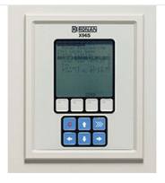
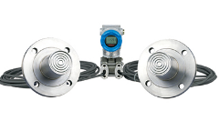
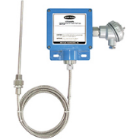

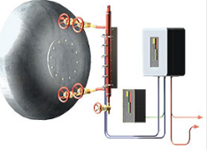
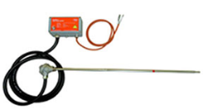
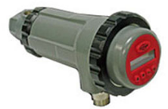
INSTRUMETATION Conti..
Nucleonic Process
Measurement
Nucleonic Level
Detection
Pressure Measurement
Temperature Measurement
Overfill Prevention Controller
Level Indicator
Igniters & Pilot
Flame Scanners

Slide 14
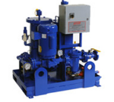
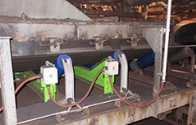
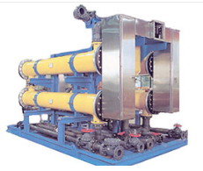
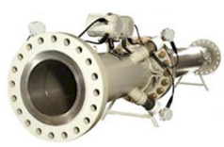
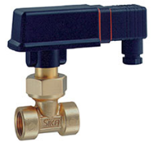
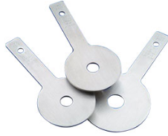


INSTRUMETATION
Belt conveyor protection
Oil Conditioning
Electro Chemical
Custody Measurement
Flow Switches
Flow Element
Liquid Level Gauges
Liquid Level Switch

Slide 15








GENERAL
Chemicals Reinol
Gasket and Sheeting
Entanorm Entanorm
Anchor Industries
Paint
Abrasives
Lashes
Power Tools

Slide 16








Popular Product Ranger
Camlock Canopy
Camlock Couplings
Flange Bellows
Idlers and Rollers
Washer and Bearings
Plates/ Face Plates
Pulp & Slurry Hoses
Ventilation
Mechanical Roof Bolts

Slide 17








Testing Equipment & Electrical
MT970 Particle Counter
Cable Cutter
10kv Insulation Tester
Multi-Function Tester
High Voltage Insulation
ELCB Tester Tel28 Toptronic
Thermometer Non-Contact
Leak Clamp Meter

Slide 18








Electrical OR Power Tester
Fluke 17B+ Digital Multimeter
Insulation Testers
Power Analyzer
12v26AH Battery
Isolator Distribution Board
Floodlight
Refuge bay Light
Fusion Splicer fibres

Slide 19








UNDERGROUD EQUIPMENET
Motion SCOUT
Cap lamp
V-Tec
V-Form
Oxygen Self Rescuer
Advantage 200LS
PH Meter

Slide 20








MHE Equipment
Forks
Solid Rubber Trolley wheel
Full Suspension Seat
Pallet Trolley
Double Drum Handling
Mobile Safety step Lad
Trolley
Trolley wheels

Slide 21








Locomotive spares components
Locomotive Lights
Coupling Houses
Brake valve Repair
Brake shoe
Diesel Engine Components
Filter element
Automatic Coupler
Compressor spares

Slide 22






STATIONERY
PERSONAL PROTECTIVE EQUIPMENT

Slide 23








Maintenance and Services
Building Construction
Roof Sheeting
Renovation/Roof repair
Plumbing/Electrify
Paving/Painting/Plumbing/grass cutting
Plumbing Services

Slide 24







Maintenance and Services
Building Construction
Roof Sheeting
Renovation/Roof repair
Plumbing/Electrify
Paving/Painting/Plumbing/grass cutting
Plumbing Tools

Slide 25






Building And Walkway Maintenance

Slide 26






Fire Prevention solution, Product as well as Installation

Slide 27
Claude Mashau
073 566 2161
phepoholdings@gmail.com

